Slide 1
Kernel Methods and Gaussian Processes
Pattern Recognition, 2023

Slide 2
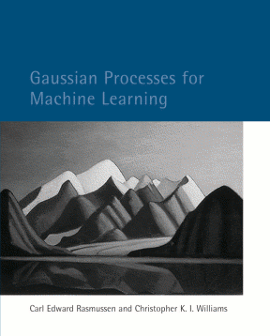
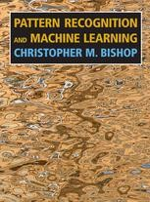
Main References
Gaussian Processes for Machine Learning (GPML), Carl Edward Rasmussen and Christopher K. I. Williams, 2006
Pattern Recognition and Machine Learning (PRML), Christopher. M. Bishop, 2007
Course “Machine learning with kernel methods” in ENS Paris, by Julien Mairal and Jean-Philippe Vert
https://members.cbio.mines-paristech.fr/~jvert/svn/kernelcourse/course/2021mva/index.html
Gaussian Process Summer School (yearly held in Sheffield, UK)
http://gpss.cc/
Includes tutorials (videos and slides), lab exercises and some recent progresses

Slide 3
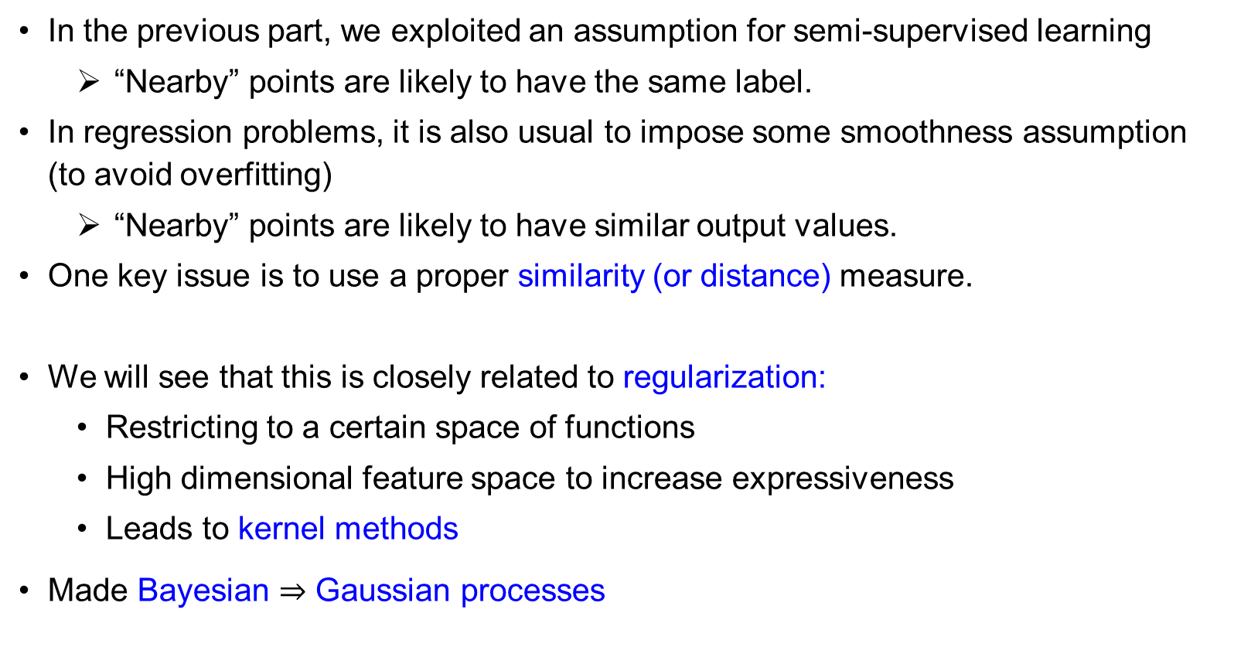
Motivation
In the previous part, we exploited an assumption for semi-supervised learning
“Nearby” points are likely to have the same label.
In regression problems, it is also usual to impose some smoothness assumption (to avoid overfitting)
“Nearby” points are likely to have similar output values.
One key issue is to use a proper similarity (or distance) measure.
We will see that this is closely related to regularization:
Restricting to a certain space of functions
High dimensional feature space to increase expressiveness
Leads to kernel methods
Made Bayesian $⇒$ Gaussian processes

Slide 4
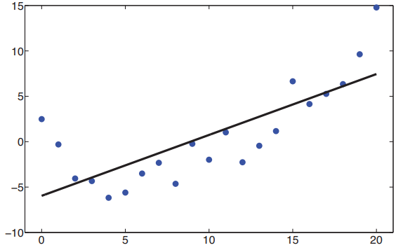
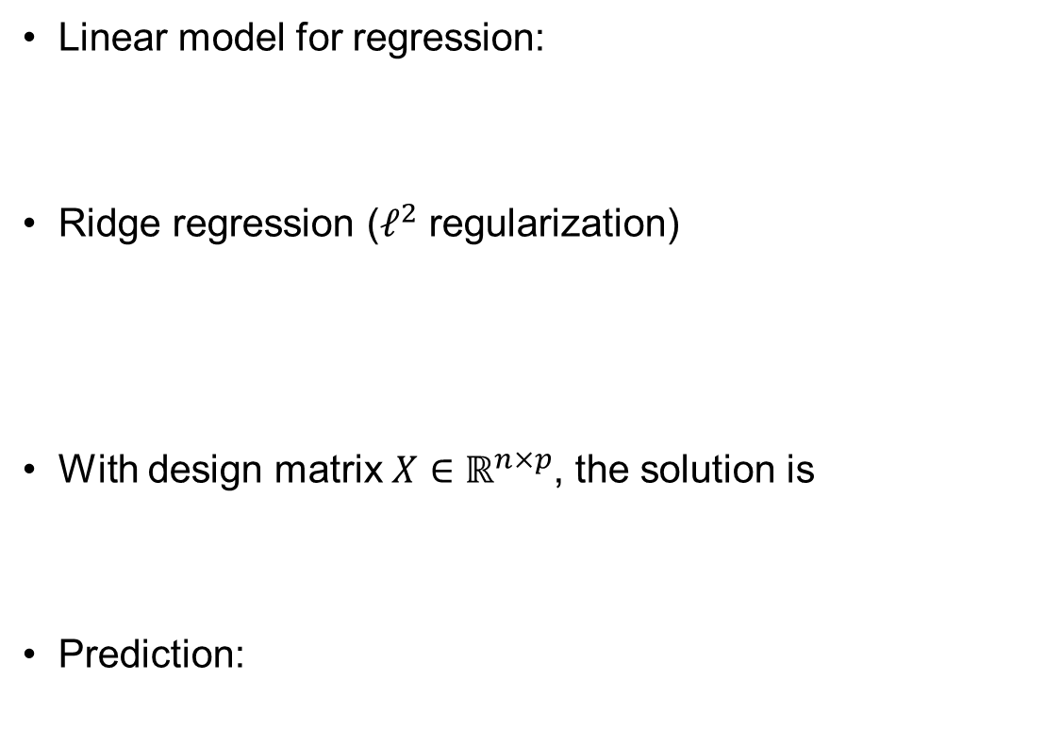
Linear Regression Revisited
Linear model for regression:
Ridge regression ($ℓ^{2}$ regularization)
With design matrix $X∈ℝ^{n×p}$, the solution is
Prediction:

Slide 5
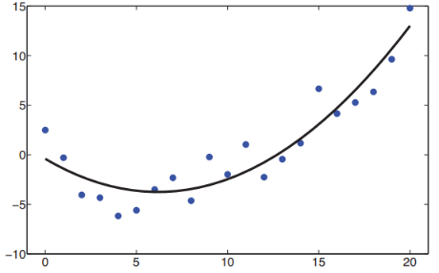
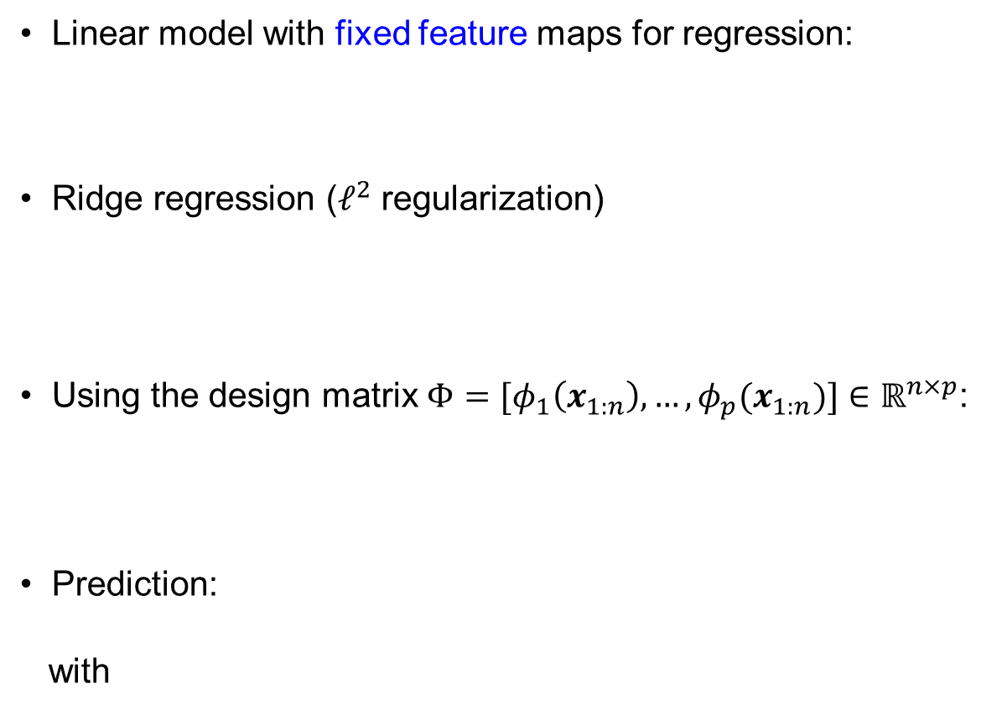
Linear Regression with Features
Linear model with fixed feature maps for regression:
Ridge regression ($ℓ^{2}$ regularization)
Using the design matrix $Φ=[φ_{1}\left(x_{1:n}\right),…,φ_{p}(x_{1:n})]∈ℝ^{n×p}$:
Prediction:
with

Slide 6
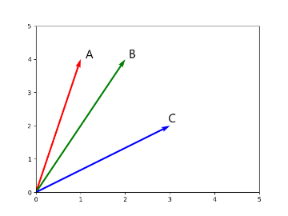
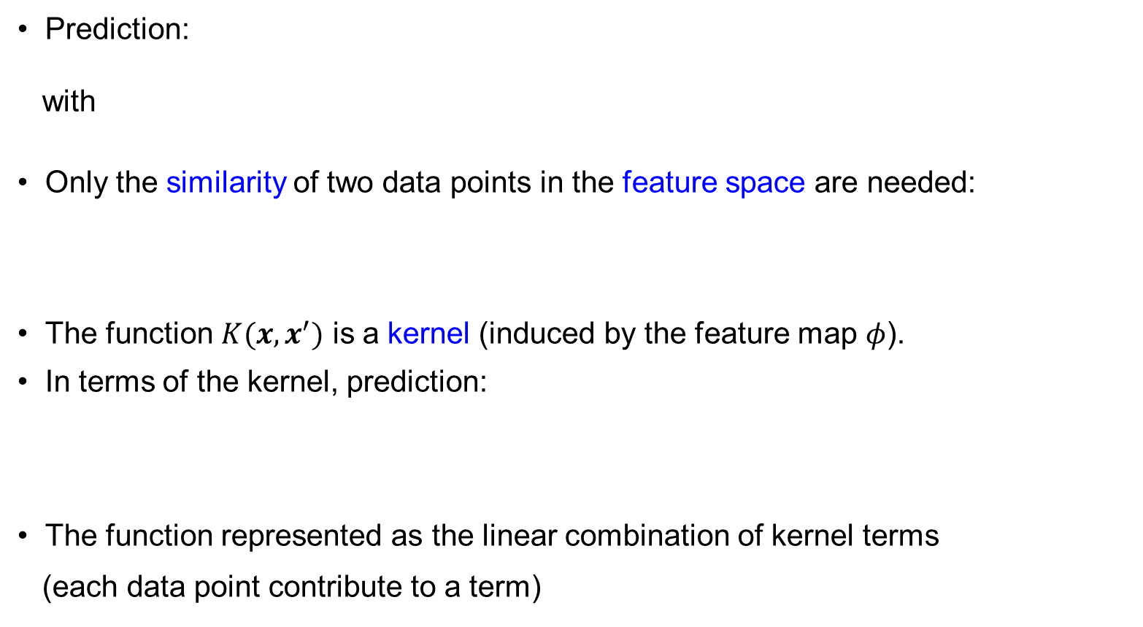
From Feature to Kernel
Prediction:
with
Only the similarity of two data points in the feature space are needed:
The function $K(x,x^{′})$ is a kernel (induced by the feature map $φ$).
In terms of the kernel, prediction:
The function represented as the linear combination of kernel terms
(each data point contribute to a term)

Slide 7
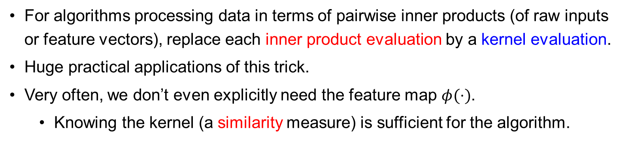
Kernel Trick – First Look
For algorithms processing data in terms of pairwise inner products (of raw inputs or feature vectors), replace each inner product evaluation by a kernel evaluation.
Huge practical applications of this trick.
Very often, we don’t even explicitly need the feature map $φ(⋅)$.
Knowing the kernel (a similarity measure) is sufficient for the algorithm.
Notes:
Computationally, there are cases with many features (infinitely many in the non-parametric limit).

Slide 8
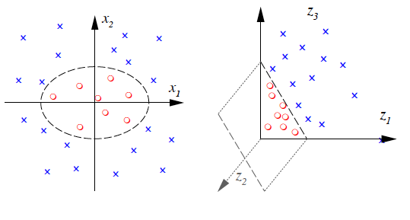
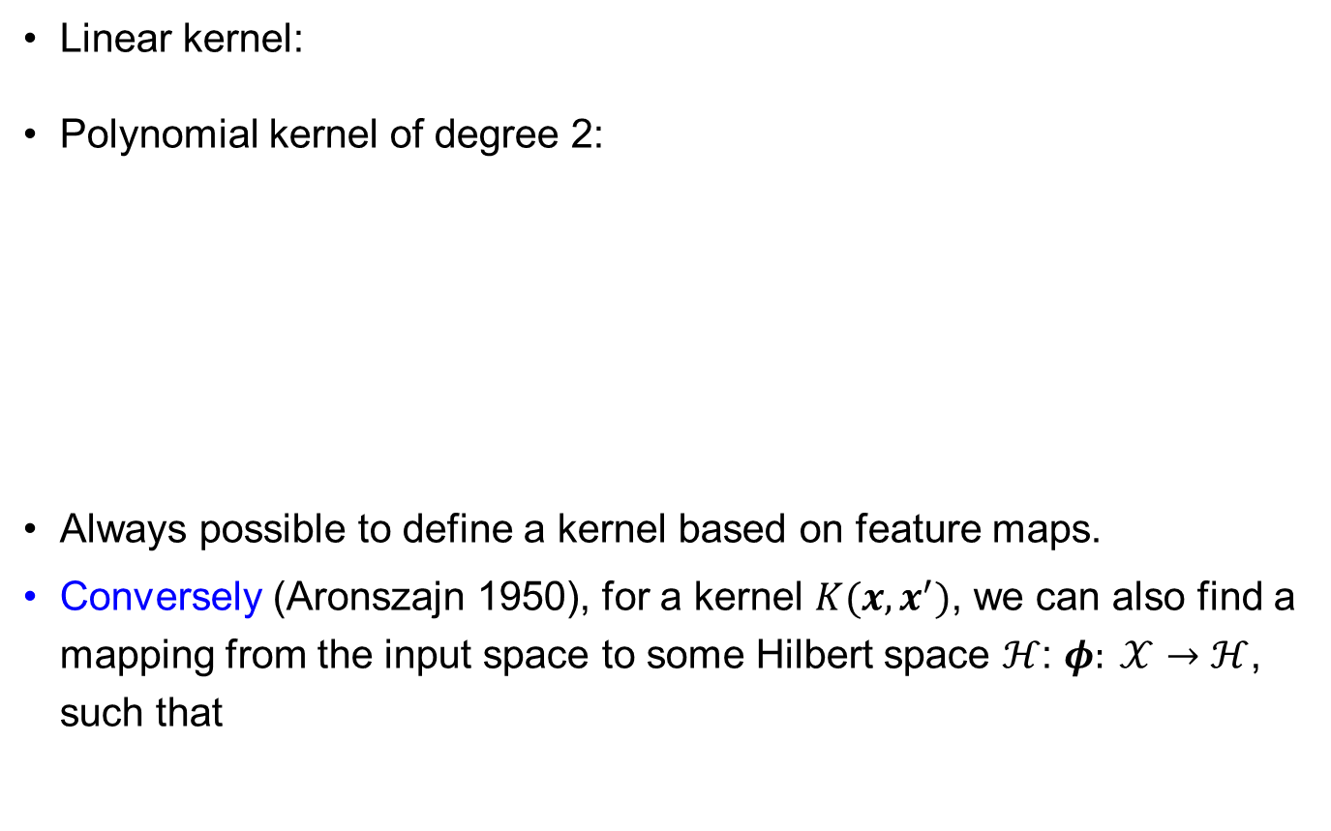
Examples of Kernels
Linear kernel:
Polynomial kernel of degree 2:
Always possible to define a kernel based on feature maps.
Conversely (Aronszajn 1950), for a kernel $K(x,x^{′})$, we can also find a mapping from the input space to some Hilbert space $ℋ$: $φ: 𝒳→ℋ$, such that
Notes:
Reason for a Hilbert space: the feature “vector” is possibly of infinite dimension.

Slide 9
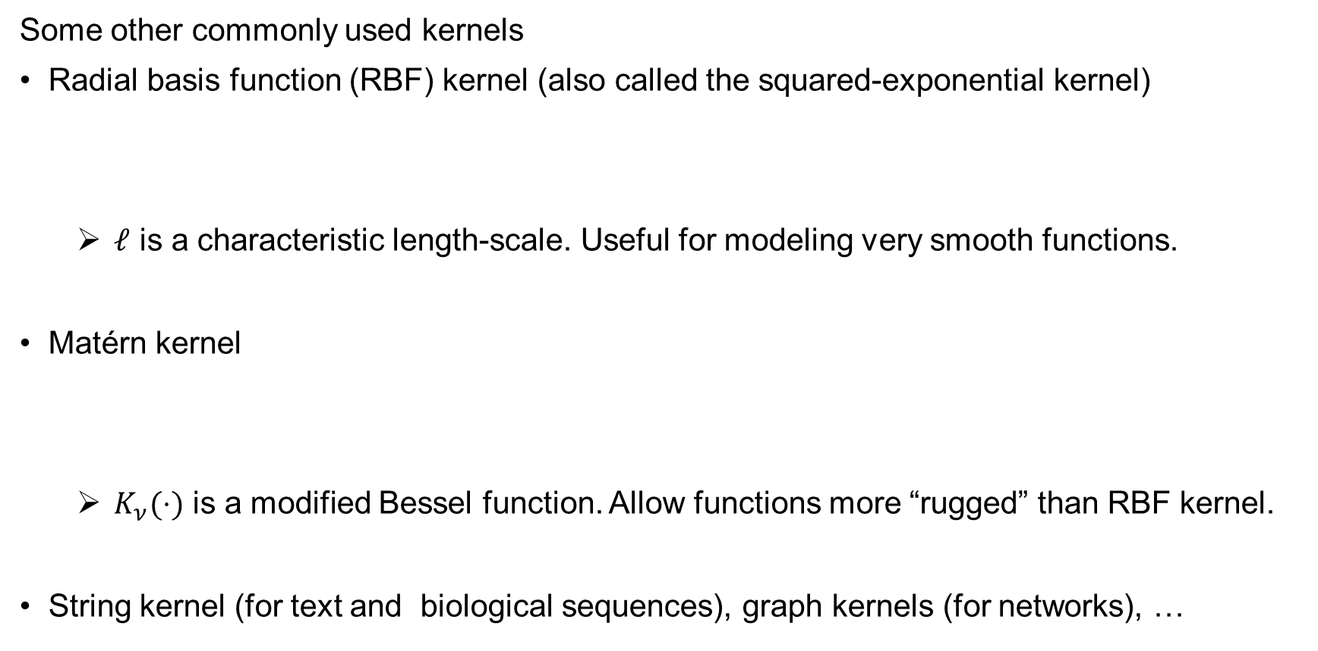
Examples of Kernels
Some other commonly used kernels
Radial basis function (RBF) kernel (also called the squared-exponential kernel)
$ℓ$ is a characteristic length-scale. Useful for modeling very smooth functions.
Matérn kernel
$K_{ν}(⋅)$ is a modified Bessel function. Allow functions more “rugged” than RBF kernel.
String kernel (for text and biological sequences), graph kernels (for networks), …
Notes:
Features of RBF kernel are no longer in the finite-D vector space.

Slide 10
Making New Kernels from Old
Consider:
Sum (= concatenation of feature spaces)
Product (= tensor product of feature space)
Other examples:

Slide 11
Reproducing Kernel Hilbert Spaces (RKHS) (Optional)

Slide 12
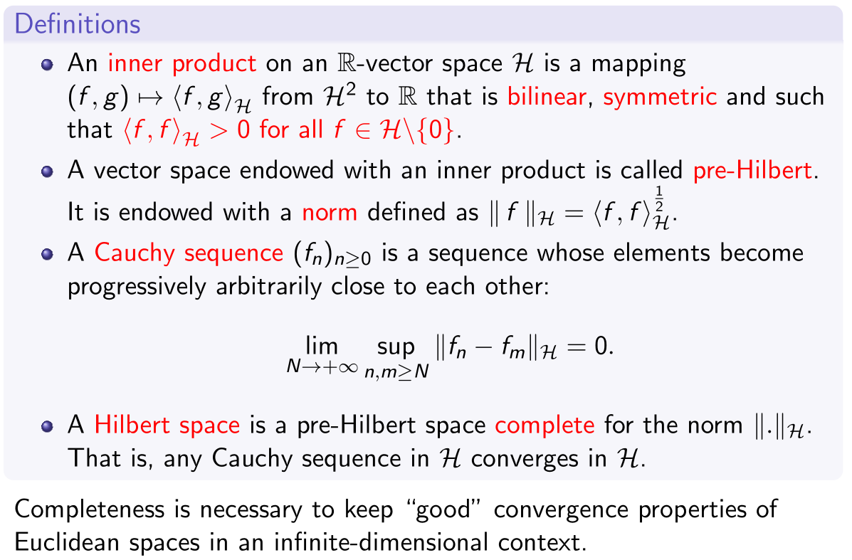
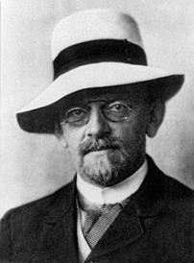
Hilbert Space
David Hilbert
1862 – 1943

Slide 13
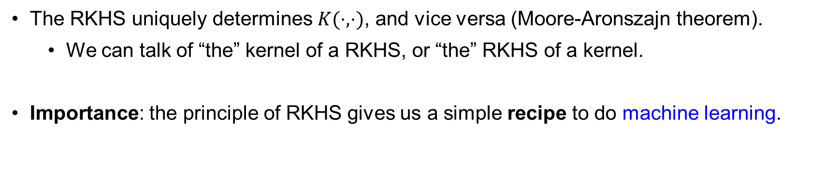
Reproducing Kernel Hilbert Spaces (RKHS)
The RKHS uniquely determines $K(⋅,⋅)$, and vice versa (Moore-Aronszajn theorem).
We can talk of “the” kernel of a RKHS, or “the” RKHS of a kernel.
Importance: the principle of RKHS gives us a simple recipe to do machine learning.

Slide 14
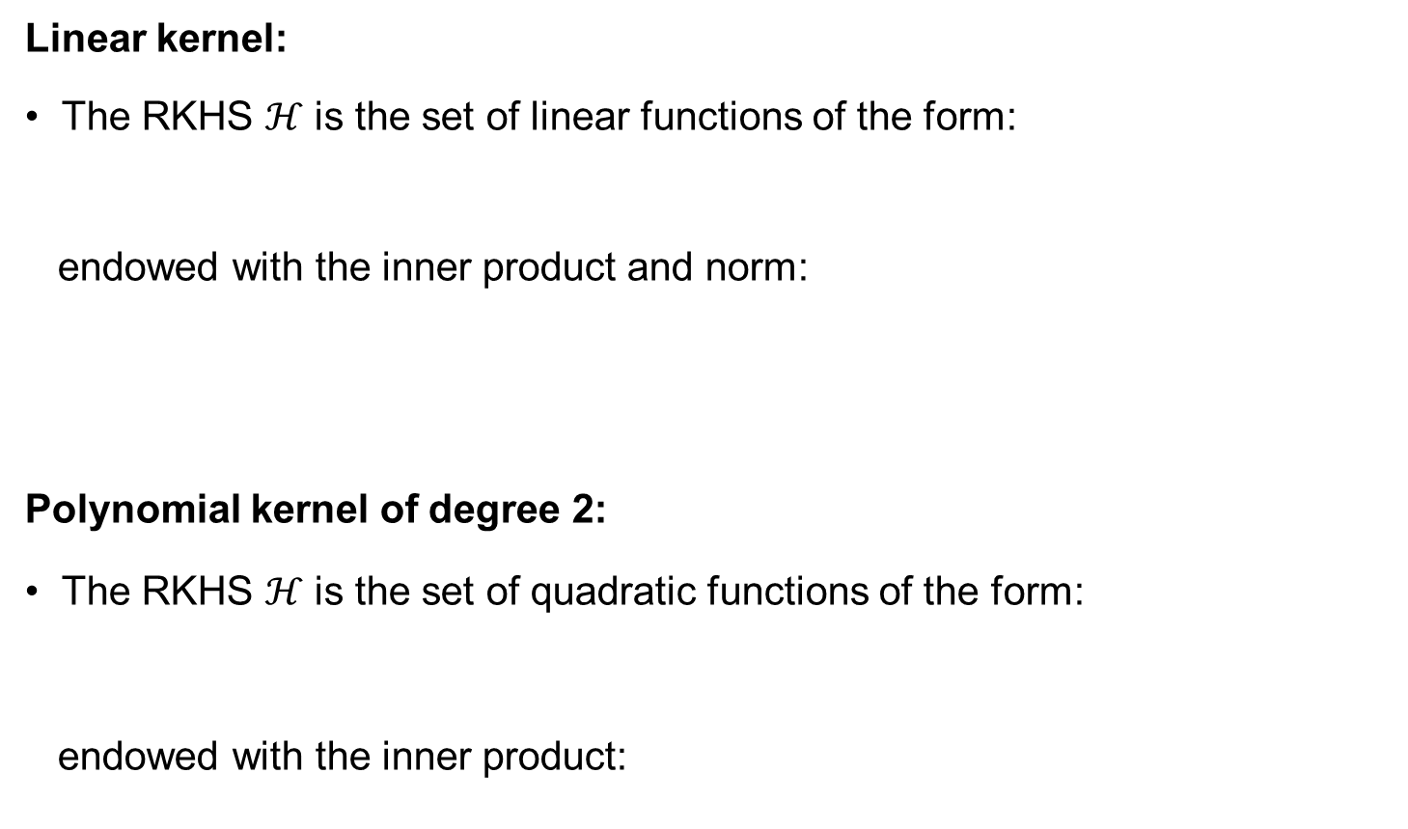
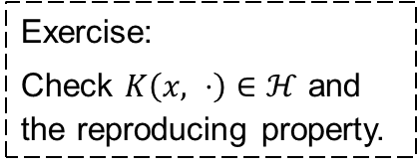
RKHS – Example
Linear kernel:
The RKHS $ℋ$ is the set of linear functions of the form:
endowed with the inner product and norm:
Polynomial kernel of degree 2:
The RKHS $ℋ$ is the set of quadratic functions of the form:
endowed with the inner product:
Exercise:
Check $K\left(x, ⋅\right)∈ℋ$ and the reproducing property.

Slide 15
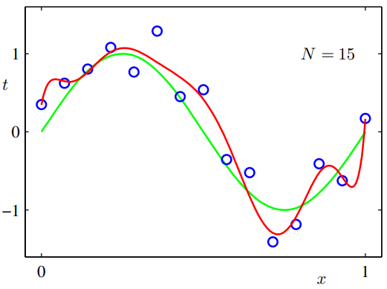
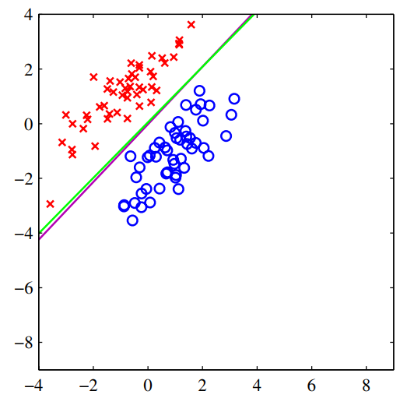
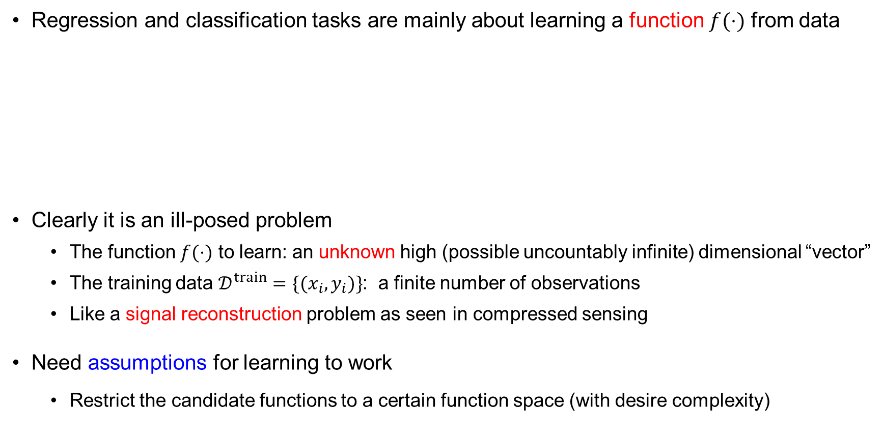
RKHS – Implications for ML
Regression and classification tasks are mainly about learning a function $f(⋅)$ from data
Clearly it is an ill-posed problem
The function $f(⋅)$ to learn: an unknown high (possible uncountably infinite) dimensional “vector”
The training data $𝒟^{train}=\{(x_{i},y_{i})\}$: a finite number of observations
Like a signal reconstruction problem as seen in compressed sensing
Need assumptions for learning to work
Restrict the candidate functions to a certain function space (with desire complexity)

Slide 16
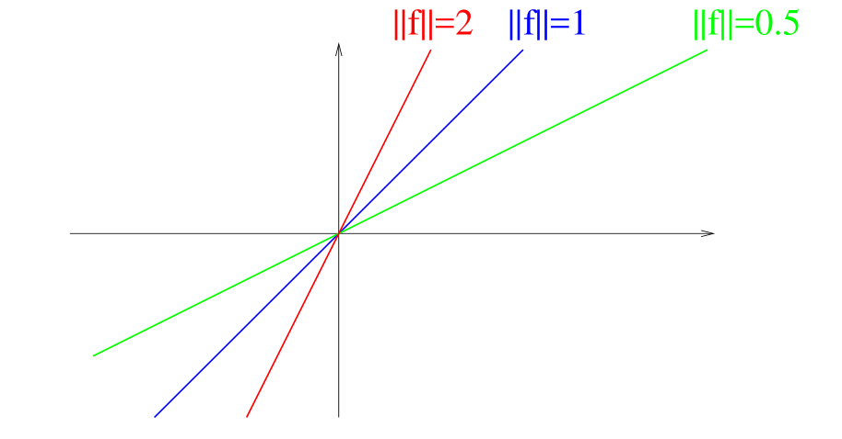
RKHS – Implications for ML
An RKHS is a space of (potentially nonlinear) functions.
Different RKHS have different properties, suitable for different tasks
Properties of functions captured by the kernel
Remember the RKHS of the linear kernel:

Slide 17
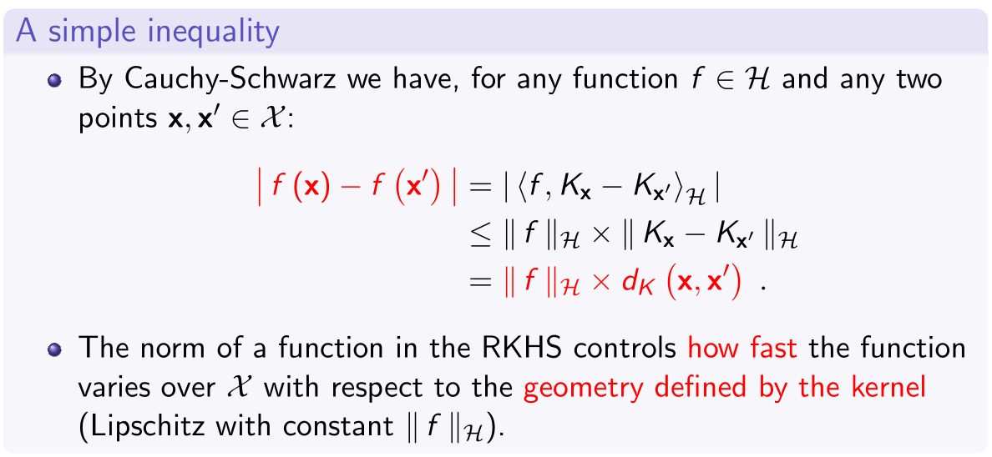

RKHS – Implications for ML
(Optional)
(Take-home)
Notes:
Proof:
1st line: use the reproducing property.
3rd line: also use the reproducing property: ${\left\langle K_{x},K_{y}\right\rangle }_{ℋ}=K_{x}\left(y\right)=K(x,y)$

Slide 18
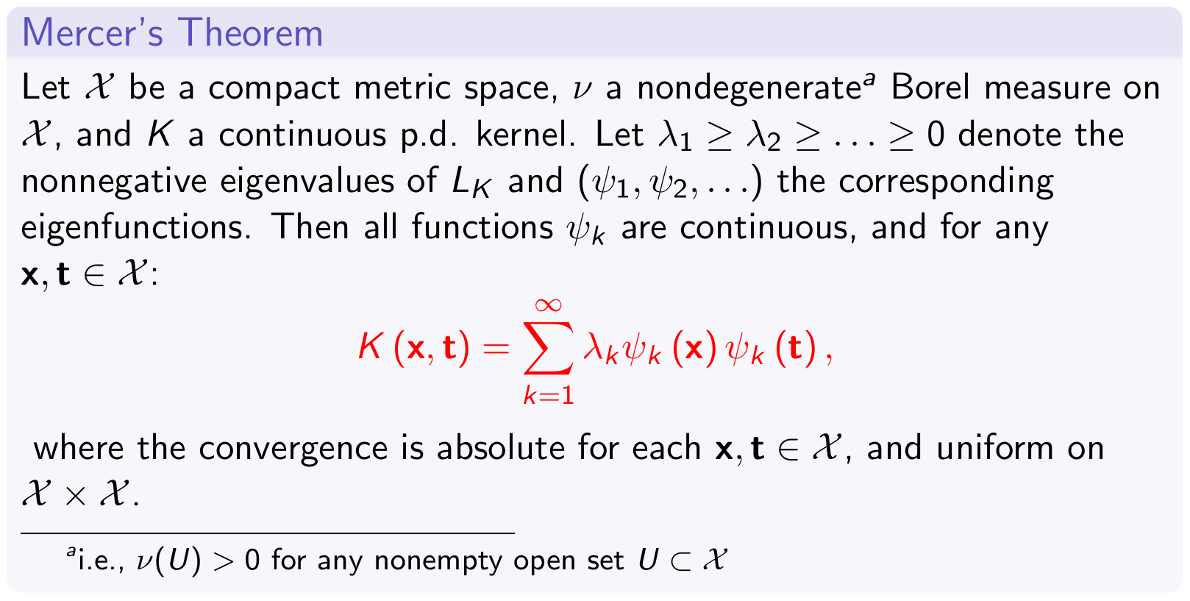
Mercer’s Theorem (Optional)

Slide 19
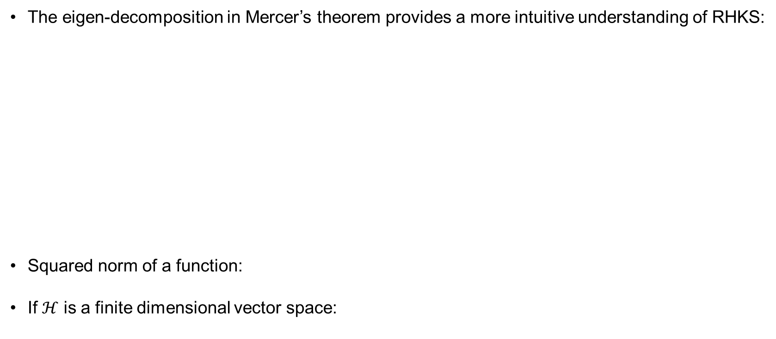
Mercer’s Theorem (Optional)
The eigen-decomposition in Mercer’s theorem provides a more intuitive understanding of RHKS:
Squared norm of a function:
If $ℋ$ is a finite dimensional vector space:
Notes:
Link to Part 3:
We’ve considered $f^{⊤}Lf$, where $L$ is the graph Laplacian.
Therefore, $L^{−1}$ (more precisely the pseudo-inverse) is a kernel.

Slide 20
Kernel Methods

Slide 21
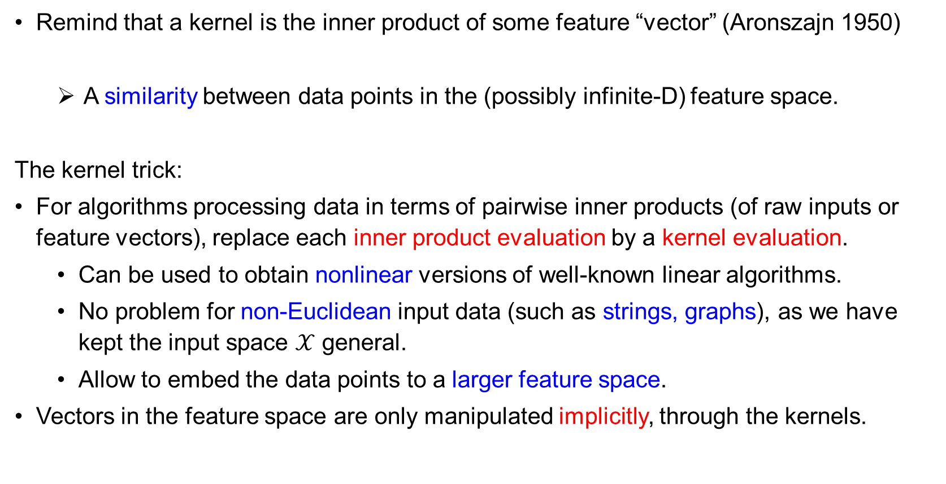
Kernel Trick
Remind that a kernel is the inner product of some feature “vector” (Aronszajn 1950)
A similarity between data points in the (possibly infinite-D) feature space.
The kernel trick:
For algorithms processing data in terms of pairwise inner products (of raw inputs or feature vectors), replace each inner product evaluation by a kernel evaluation.
Can be used to obtain nonlinear versions of well-known linear algorithms.
No problem for non-Euclidean input data (such as strings, graphs), as we have kept the input space $𝒳$ general.
Allow to embed the data points to a larger feature space.
Vectors in the feature space are only manipulated implicitly, through the kernels.

Slide 22
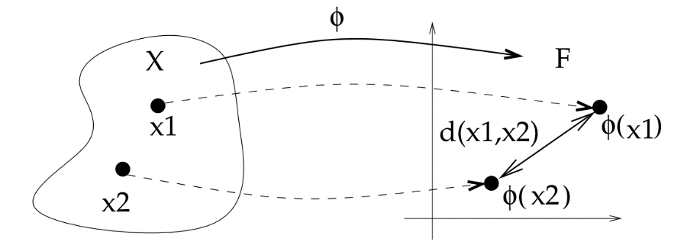
Kernel Trick – Example 1
Computing distances in the feature space

Slide 23
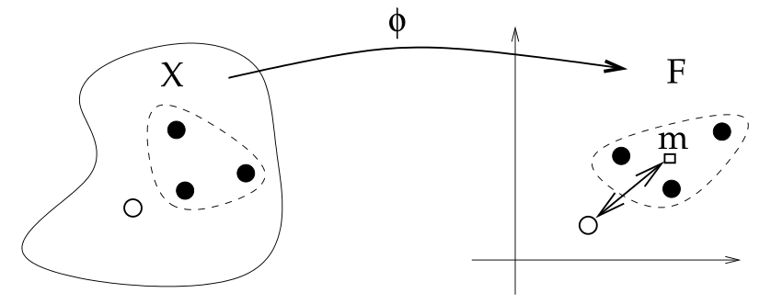
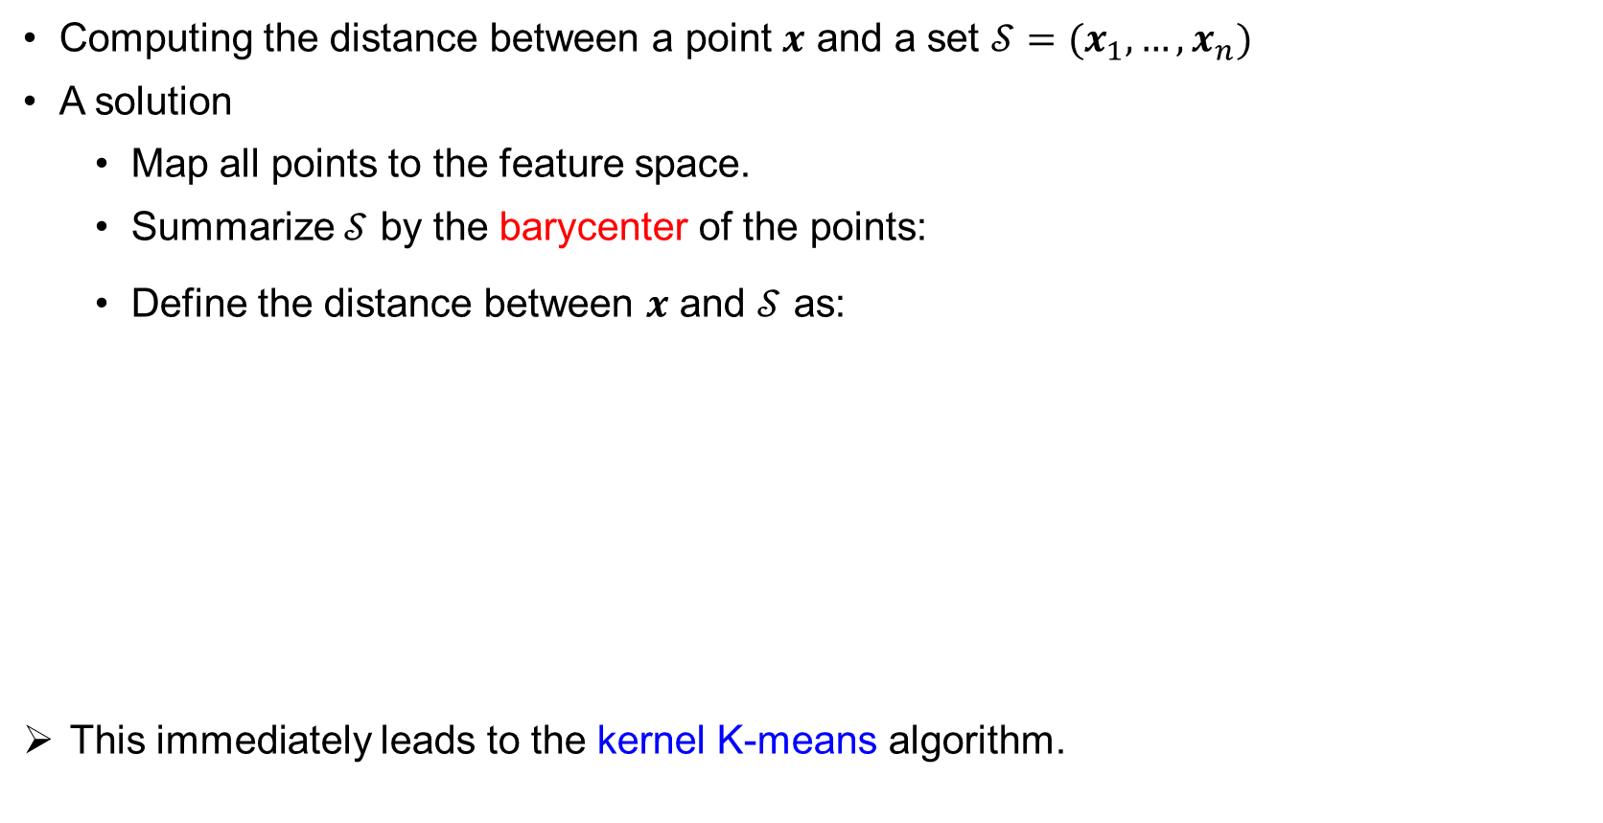
Kernel Trick – Example 2
Computing the distance between a point $x$ and a set $𝒮=(x_{1},…,x_{n})$
A solution
Map all points to the feature space.
Summarize $𝒮$ by the barycenter of the points:
Define the distance between $x$ and $𝒮$ as:
This immediately leads to the kernel K-means algorithm.

Slide 24
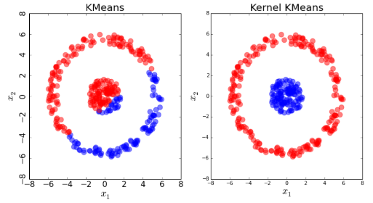
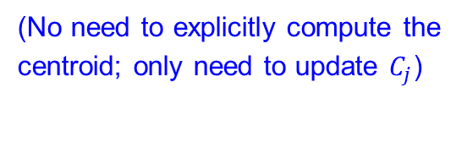
Application – Kernel K-means
K-means alternates between two steps:
Kernel K-means
(Only kernel evaluation needed)
(No need to explicitly compute the centroid; only need to update $C_{j}$)
Pyclust in Python:
https://github.com/vmirly/pyclust

Slide 25
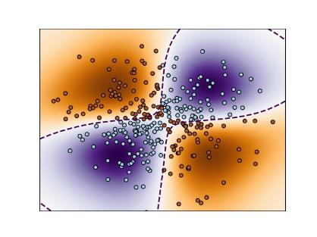
Application – Kernel SVM
Dual optimization problem of SVM:
Kernel SVM
sklearn in Python:
https://scikit-learn.org/stable/modules/classes.html#module-sklearn.svm
(RBF kernel in used)

Slide 26
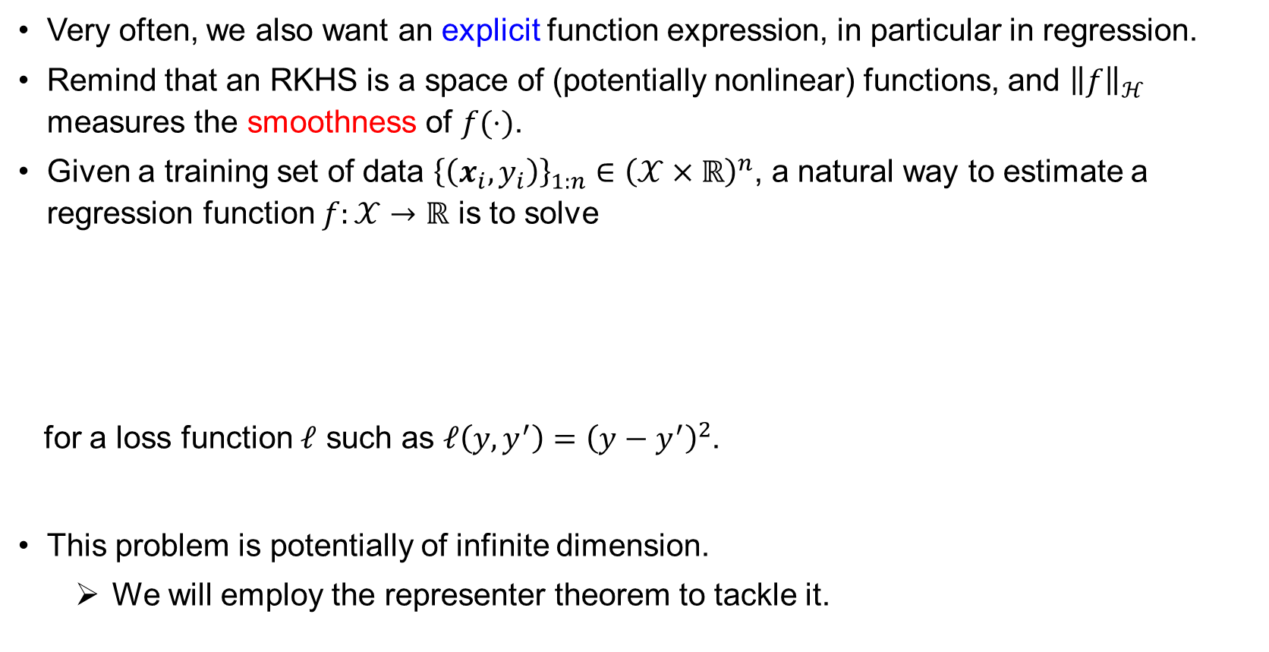
The Representer Theorem
Very often, we also want an explicit function expression, in particular in regression.
Remind that an RKHS is a space of (potentially nonlinear) functions, and ${\left\|f\right\|}_{ℋ}$ measures the smoothness of $f(⋅)$.
Given a training set of data ${\left\{\left(x_{i},y_{i}\right)\right\}}_{1:n}∈{\left(𝒳×ℝ\right)}^{n}$, a natural way to estimate a regression function $f:𝒳→ℝ$ is to solve
for a loss function $ℓ$ such as $ℓ\left(y,y^{′}\right)={\left(y−y^{′}\right)}^{2}$.
This problem is potentially of infinite dimension.
We will employ the representer theorem to tackle it.

Slide 27
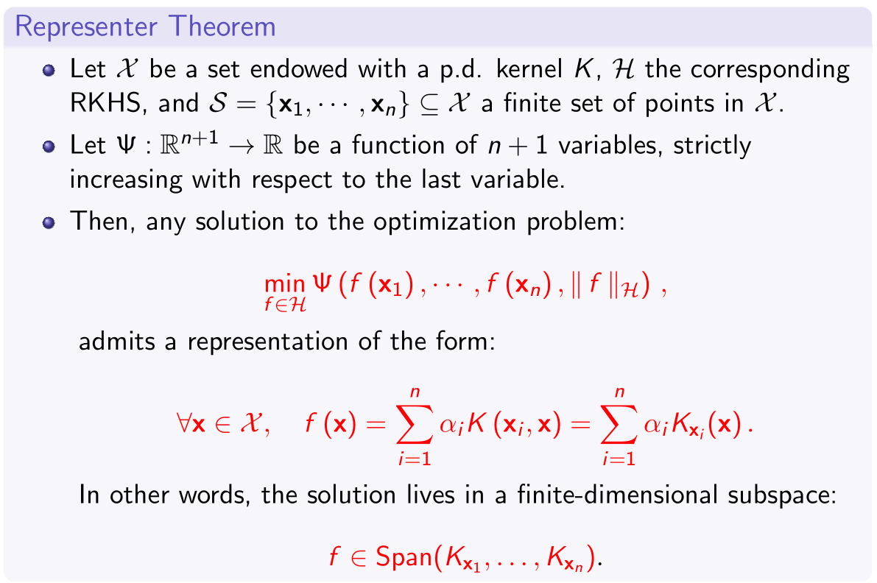
The Representer Theorem

Slide 28
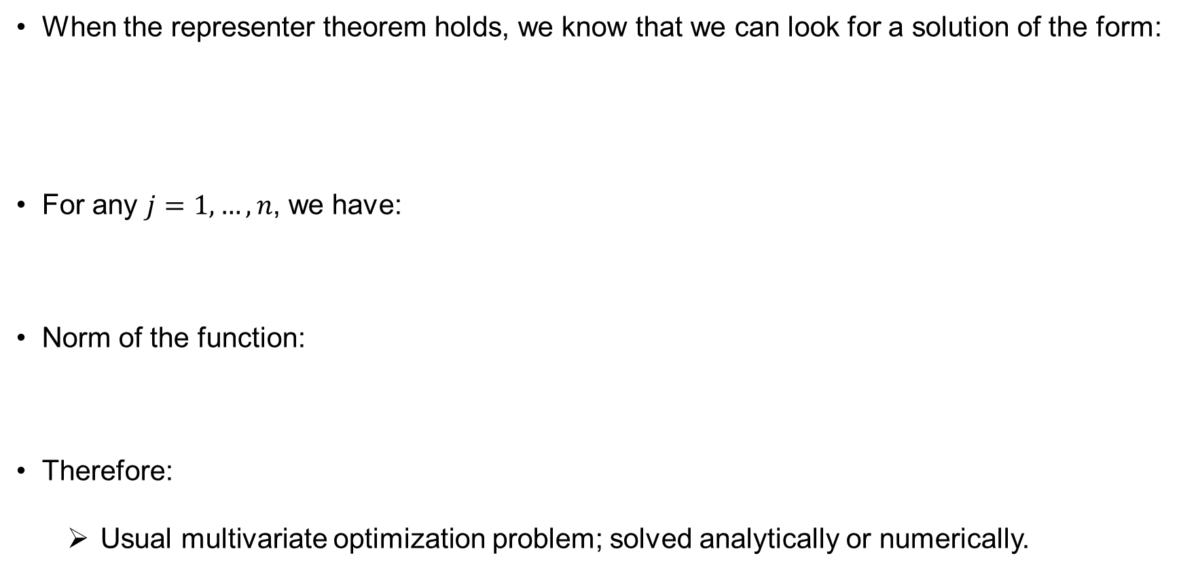
The Representer Theorem – Practical Use
When the representer theorem holds, we know that we can look for a solution of the form:
For any $j=1,…,n$, we have:
Norm of the function:
Therefore:
Usual multivariate optimization problem; solved analytically or numerically.

Slide 29
Application – Kernel Ridge Regression
Denote:
We can also write:
Then:
A convex quadratic programming problem.
Solution:
$⇒$ Unsurprisingly, the same solution as in Page. 6.

Slide 30
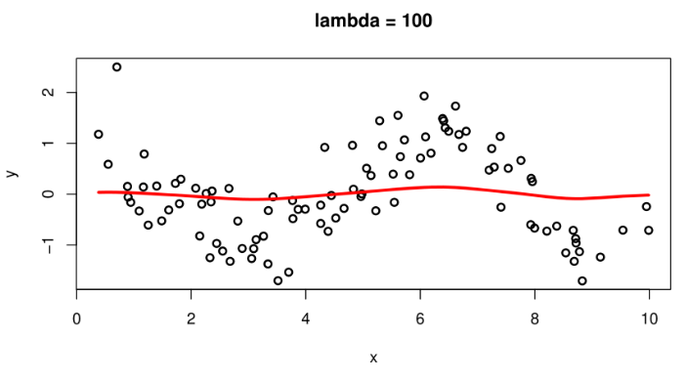
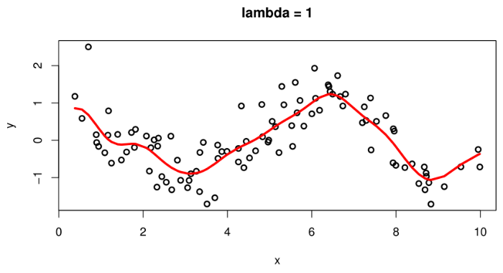
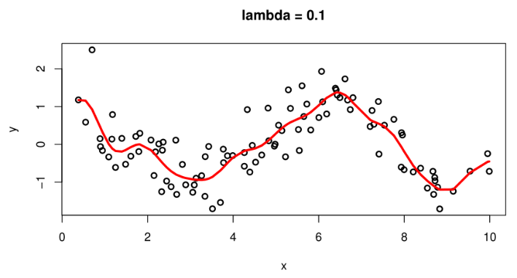
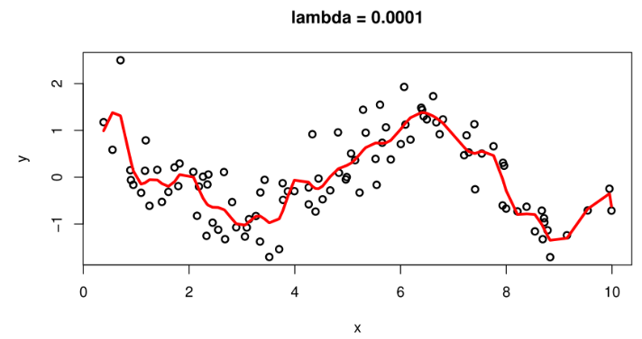
Application – Kernel Ridge Regression
(RBF kernel in use)

Slide 31
Gaussian Processes

Slide 32
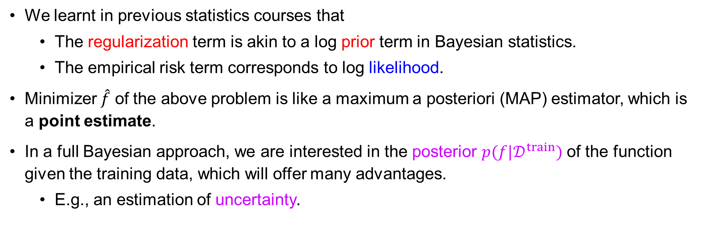
Full Bayesian Approach
We learnt in previous statistics courses that
The regularization term is akin to a log prior term in Bayesian statistics.
The empirical risk term corresponds to log likelihood.
Minimizer $\hat{f}$ of the above problem is like a maximum a posteriori (MAP) estimator, which is a point estimate.
In a full Bayesian approach, we are interested in the posterior $p(f|𝒟^{train})$ of the function given the training data, which will offer many advantages.
E.g., an estimation of uncertainty.

Slide 33
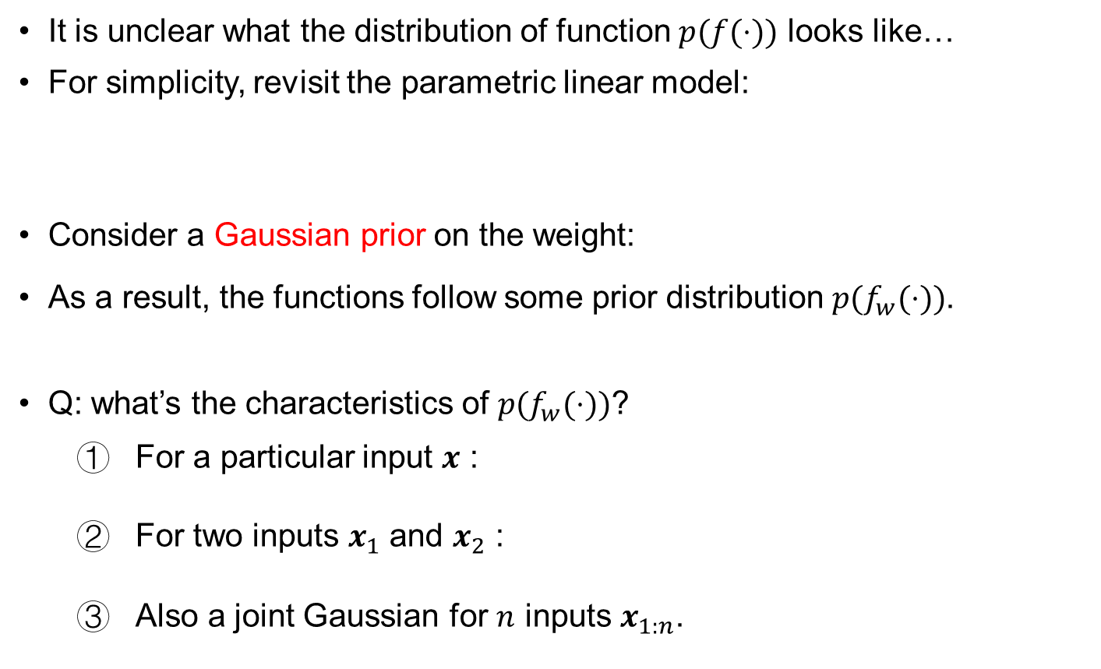
Weight-space View
It is unclear what the distribution of function $p(f(⋅))$ looks like…
For simplicity, revisit the parametric linear model:
Consider a Gaussian prior on the weight:
As a result, the functions follow some prior distribution $p(f_{w}(⋅))$.
Q: what’s the characteristics of $p(f_{w}(⋅))$?
For a particular input $x$ :
For two inputs $x_{1}$ and $x_{2}$ :
Also a joint Gaussian for $n$ inputs $x_{1:n}$.

Slide 34
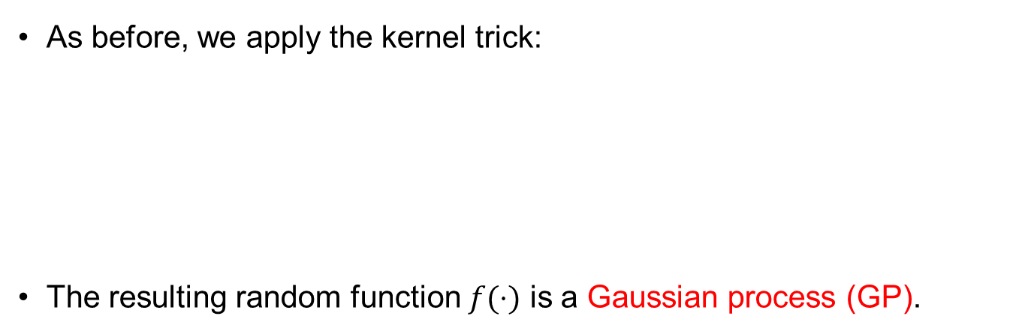
Function-space View – Gaussian Processes
As before, we apply the kernel trick:
The resulting random function $f(⋅)$ is a Gaussian process (GP).

Slide 35
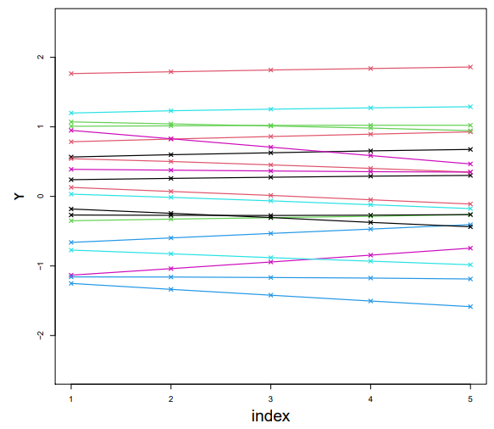
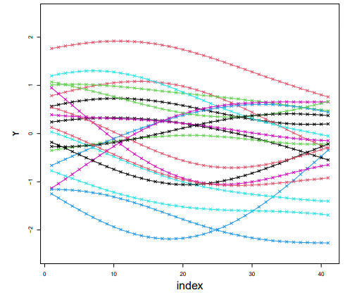
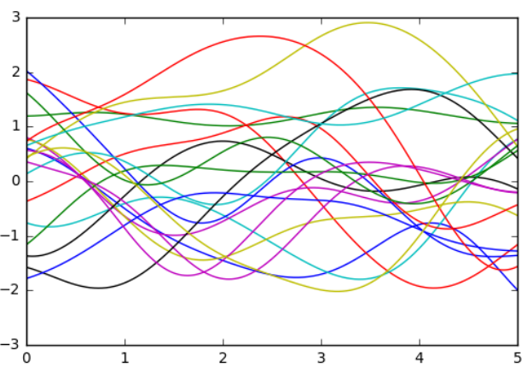
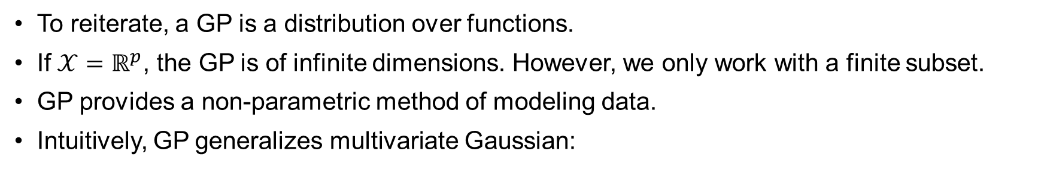
Gaussian Processes (GPs)
To reiterate, a GP is a distribution over functions.
If $𝒳=ℝ^{p}$, the GP is of infinite dimensions. However, we only work with a finite subset.
GP provides a non-parametric method of modeling data.
Intuitively, GP generalizes multivariate Gaussian:
Notes:
Each line in the figure is a realization of the random vector/process.

Slide 36
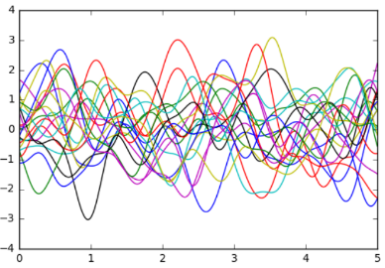
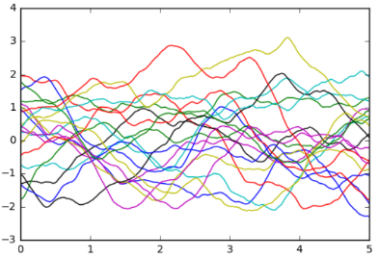
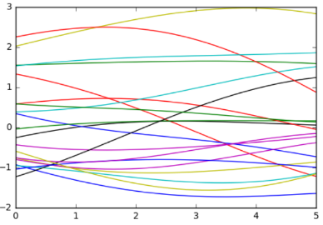
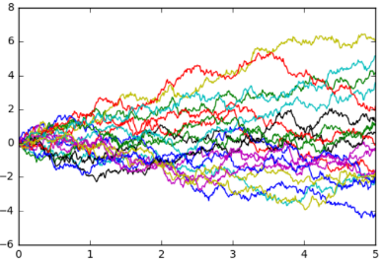
Gaussian Processes – Kernels
Like the empirical risk minimization using RKHS regularization, the kernel of a GP specifies the prior properties of the functions.

Slide 37


Gaussian Processes – Why Gaussian
We have chosen a Gaussian prior, which can be motivated from its universality and analytical tractability.
(i) Linear operation preserves Gaussian:
Special case: sum of Gaussians (e.g., $y_{1}+y_{2}$) is a Gaussian
(ii) Marginal of a Gaussian is a Gaussian:

Slide 38


Gaussian Processes – Why Gaussian
(iii) Conditional of a Gaussian is a Gaussian:
Proof by directly computing
Intuition:

Slide 39

Gaussian Processes for Regression (1)
The conditional property of Gaussian tells us how to perform Bayesian inference in GP.
This is how we do regression using GP.
Let $f$ be a GP with zero mean function, and covariance function (kernel) $K(⋅, ⋅)$
Consider $X=x_{1:n}$ as the set of training inputs.
Consider $x_{∗}$ as the point to predict. Then a priori:
with:

Slide 40

Gaussian Processes for Regression (2)
Further consider that the observation is noisy:
Then:
with:
Graphical model for noisy GP regression:

Slide 41



Gaussian Processes for Regression (3)
Using the conditional of Gaussian as before, the posterior marginal of $f\left(x_{∗}\right)$ is:
More generally, the posterior of $f(⋅)$ is a also GP:

Slide 42

Model Selection
GP is a non-parametric model, but it still has hyper-parameters to adapt, e.g., the length scale of the RBF kernel.
More generally, one needs to choose among different kernels.
These are model selection problems.
There are a few ways to do this in the Bayesian approach (see Chap. 5 in GPML). Here we introduce an elementary method by maximizing the marginal likelihood (or evidence).

Slide 43

Model Selection
Fortunately, the marginal (log) likelihood can be easily obtained in GP
This can be used to directly compare two GP models.
Hyper-parameter adaptation (learning) of kernels can also be done by maximizing $\log{p(y|X,θ)}$, e.g., by gradient descent.
The following matrix identities will be useful in computing the gradient:

Slide 44



GP Regression – Example
An artificial example showing the effect of length scale $ℓ$ in RBF kernel.
Application in computational fluid dynamics simulation.
https://doi.org/10.1016/j.ijheatfluidflow.2019.108497

Slide 45


GP Regression – Kernel Design
2005 (when GPML was written)
Atmospheric concentration of CO₂ [Chap. 5, GPML]
(Richer set of features by combining kernels.)
Reality (after 6 years) vs prediction http://learning.eng.cam.ac.uk/carl/mauna/
More on kernel design
Chap. 4, 5, GPML
PhD thesis of David Duvenaud
https://www.cs.toronto.edu/~duvenaud/thesis.pdf
Notes:
Sum of kernels: like OR operation
Product of kernels: like AND operation
(https://www.cs.toronto.edu/~duvenaud/cookbook/)

Slide 46



Bayesian Optimization (Optional)
GP regression allows to update our posterior belief about properties of a function given the data, with uncertainty quantification.
This appears very useful for Bayesian optimization, with applications in optimizing some expensive-to-evaluate objective function $f_{true}(⋅)$,
E.g., it takes time and monetary cost to do modern physics experiments/computer simulations.
Gradient information of the function is generally not inaccessible.
Model configuration in ML: find optimal hyper-parameter, learning rates, number of layers, etc.
Adaptive experimentation: Optimize a function embodied in a physical/biological process.

Slide 47



Bayesian Optimization (Optional)
Use a probabilistic surrogate model $f(⋅)$ of the objective $f_{true}(⋅)$.
Given old data, compute the posterior predictive distribution of $f(⋅)$.
We use GP regression for these two purposes.
Define an acquisition function to collect new data points
Need to simultaneously perform optimization and gain knowledge about the function
A balance between exploitation and exploration
Relative area:
Active learning
Multi-armed bandit
[“Taking the Human Out of the Loop: A Review of Bayesian Optimization”, B. Shahriari et al., 2016]

Slide 48


Neural Network Gaussian Processes (Optional)
We know that neural networks (NNs) are very powerful learning machines.
In contrast to fixed basis functions $\{φ_{a}\left(x\right)\}$ being used in kernel methods and GPs, NNs allow adaptive basis functions, parameterized by their trainable weights.
Interestingly, when weights are i.i.d. random variables, in the infinite size limit, NNs converge to GPs [Neal 1996].
Consider NNs with one hidden layer:
Similar property holds for Deep neural networks (DNNs) [J. Lee et al., ICLR2018].
Notes:
GPs defined by such kernel are called NNGPs.

Slide 49

Neural Tangent Kernel (Optional)
The Gaussian process behaviors of DNNs allow us to understand their characteristics at random initialization, under different model architectures and activation functions.
However, very little is known after weight training (e.g., through gradient-based method), except NNs with 1 or 2 layers.
A recent breakthrough [A. Jacot et al., NeurIPS2018] showed that for DNNs with infinite width, random initialization and infinitesimal learning rate, the learning dynamics of $f_{w}(⋅)$ corresponds to kernel regression with the neural tangent kernel (NTK):
Remarkably, in the abovementioned limit, the kernel $K_{NTK}(x,x′)$ remains constant, allowing many in-depth theoretical analysis. This is called a lazy training regime.
As the NTK is unchanged (for fitting data), lazy training does not explain the feature (representation) learning aspect of DNNs. This and related issues are still under active research.

Slide 50
Implementation
Many existing software for GP, e.g.,
GPy: https://github.com/SheffieldML/GPy
GPflow: https://www.gpflow.org/
GPytorch: https://gpytorch.ai/
Good tutorials on using GPy for GP regression and other
http://gpss.cc/gpss21/labs
Recommend to go through “Lab 1” to help you bridge the gap between the theory of GP and practice.

Slide 51

Summary
GP: Pros
A natural Bayesian framework
Predictions with uncertainty quantification
Mathematical tractability
Empirical success
GP: Cons
Computational complexity $O(n^{3})$
However, massive amount of works to address this
No feature (representation) learning
“Have we thrown the baby out with the bath water?”
“According to the hype of 1987, neural networks were meant to be intelligent models that discovered features and patterns in data. Gaussian processes in contrast are simply smoothing devices.
…
The success of Gaussian processes shows that many real-world data modelling problems are perfectly well solved by sensible smoothing methods. The most interesting problems, the task of feature discovery for example, are not ones that Gaussian processes will solve. But maybe multilayer perceptrons can’t solve them either. Perhaps a fresh start is needed…”
– David J.C. MacKay, 2003
As in 2020s, we are witnessing the successes of neural networks for feature discovery.
Still an ongoing story.

Slide 52

In This Course…

Slide 53
Thank you!

